Slide 1
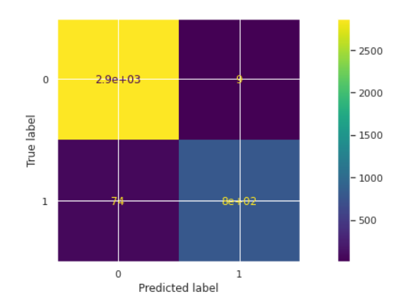
Machine Learning Model Outcome
Executive summary report for Salford Motors
The Salford Motors data team seeks to develop a model to assist in the prediction of employees leaving the company. Investigations into the data revealed various groups of that are at risk of leaving – the resulting model will meet all performance requirements.
Salford Motors is experiencing higher-than-normal employee resignations and is unsure where the issues lie. HR has collected data from 15k employees and seeks a way to identify the root cause of their high-rate resignations.
The data team has built a tree based classification model that is used to predict on the test set (with validation set aside for additional model comparison) and scored by accuracy, recall, precision, and F1 metrics.
The random forest model performed well, producing a high F1 score (0.950) and little misclassifications.
Analysis indicated that satisfaction level is the highest predictor, followed by factors that relate to burnout and performance (tenure, number of projects, average monthly hours, and last evaluation). We can conclude that the amount of work is playing a large role in turnover while pay and department are not good predictors of the problem.
Image Alt-Text Here
As noted, the model performed well but there is validation data held for testing additional models for better performance. Furthermore, the data team suggests investigating how work load is distributed to prevent burnout or boredom.

